Slide 1
What is Android?
Android is an open source and Linux-based Operating System for mobile devices such as smart phones and tablet computers.
Android was developed by the Open Handset Alliance, led by Google, and other companies.
The first beta version of the Android Software Development Kit (SDK) was released by Google in 2007 where as the first commercial version, Android 1.0, was released in September 2008.
Current latest version is Android 7.0 Nougat which released on 22 August 2016.

Slide 2
About Android Applications
Android applications are usually developed in the Java language using the Android Software Development Kit.
Once developed, Android applications can be packaged easily and sold out either through a store such as Google Play Store, Opera Mobile Store, and the Amazon Appstore.
Android powers hundreds of millions of mobile devices in more than 190 countries around the world. It's the largest installed base of any mobile platform and growing fast. Every day more than 1 million new Android devices are activated worldwide.

Slide 3
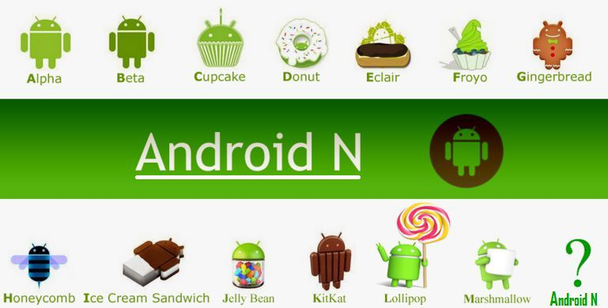
History of Android

Slide 4
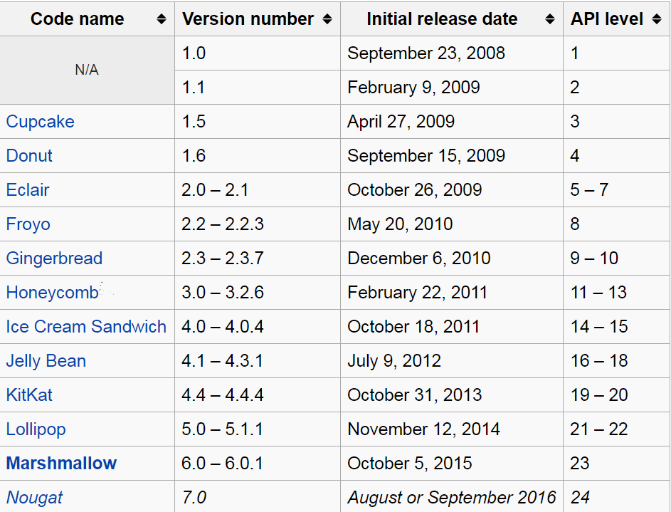
What is API level?
API (Application Programming Interface) Level is an integer value that uniquely identifies the framework.

Slide 5
Android Environment Setup
1. Supported Operating Systems:
Microsoft Windows XP or later version.
Macintosh OS 10.5.8 or later version.
Linux 2.7 or later.

Slide 6
Android Environment Setup
2. Required tools:
JDK5 (Java development Kit) or Later Version which will included Java Runtime Environment (JRE).
Android SDK( Software Development Kit).
Android Studio or Eclipse IDE (Integrated Development Environment).
Android Development Tools (ADT) Eclipse Plug-in.
After install all tools, Create (AVD) Android Virtual Device or Emulator for complete android environment setup.

Slide 7
Android Environment Setup
Steps to Installing Android Environment:
Download ADT Bundle which will be included JDK+JRE, Eclipse, SDK.
Install JDK+JRE.
Open Eclipse.
Create Work-Space folder which will store your all apps.
Link SDK with Eclipse by using this Path->
Window -> Preferences -> Android
To test your Android applications you will need a Android Virtual device. So, Create AVD (Emulator) by using this Path ->
Window -> Android Virtual Device Manager
7. Now you are ready to Make your app in Android.

